Slide 1

Sales Data Analytic
Prof. Moh'd Azzeh
Team members:
Sana Mourad
Noor Yazeed
Leen Daqa
Rand Alshoubaki

Slide 2




Introduction
In this presentation we will be showing our process and summary and visualization for sales data .

Slide 3



Our Process
-Data cleaning.by(Colab , excel)
Dropped unnecessary columns.
Dropped duplicated rows.//distinct() to know our duplicated value.
We created new features
ex: Age instead of birthdate.
-Feature selection.by (R)
.we created a new data frame with only numeric data
-Transformation. by (R)
.melt()
. organizes the data values in a long data frame format to plot multiple graphs at the same time.

Slide 4

Exploring the data
By using R:
. Summary()
-knowing how many columns, rows categories we have.
- knowing the data type for each attribute.
.unique() for our categorical columns to know our unique values to understand the data better.

Slide 5
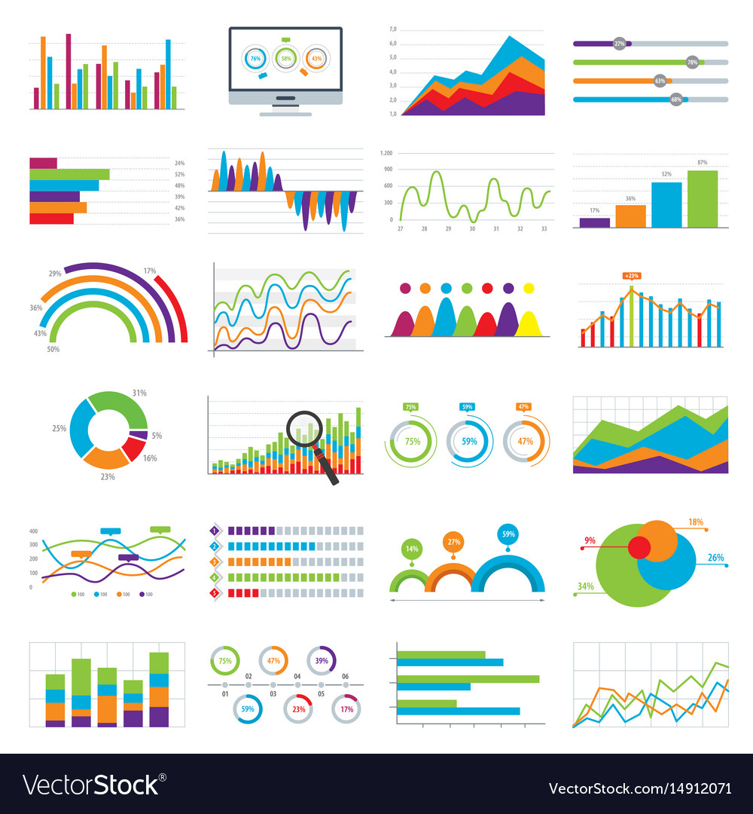
plotting and Data visualization
Box plot

Slide 6

Analyzing graphs and Looking for Relationships between the data.

Slide 7
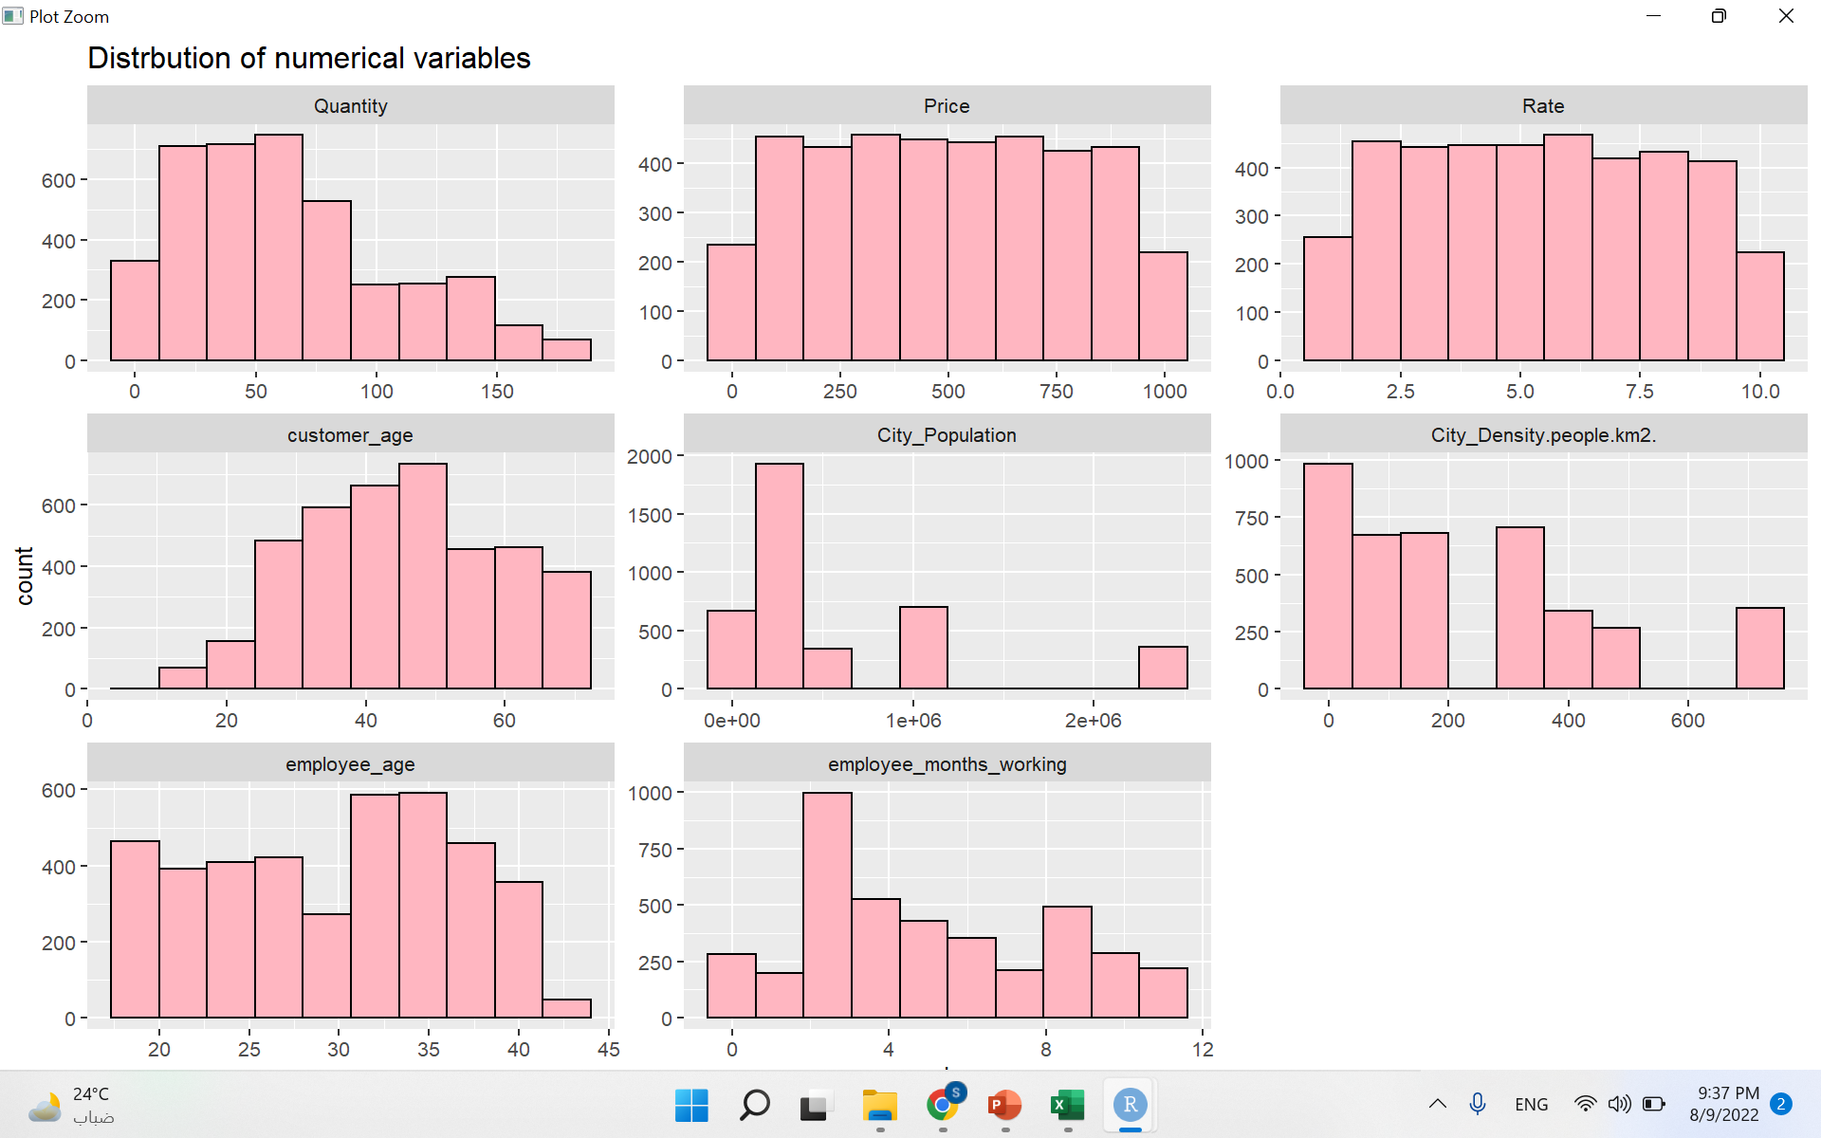
Distribution of numerical variables
This Histogram shows the distribution of numerical variable
*Note it is not clear

Slide 8
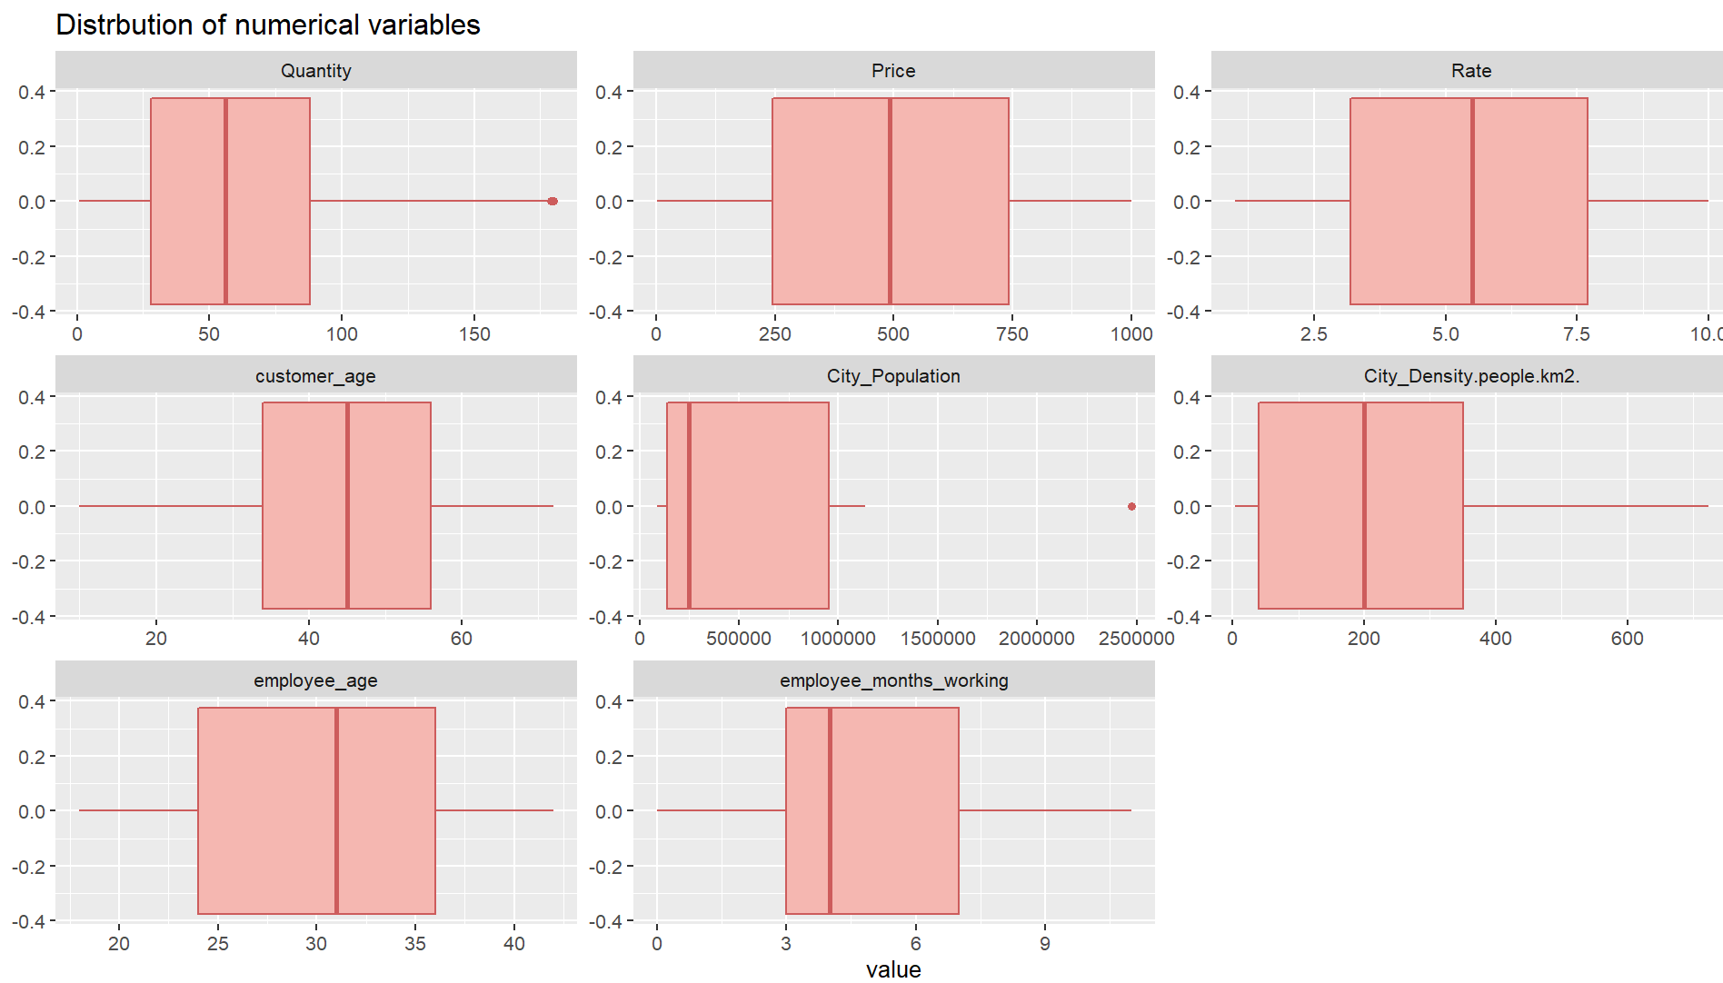
Distribution of numerical variables
This boxPlot shows the distribution of numerical variable according to mean and median
*only quantity and city population have outliers.

Slide 9
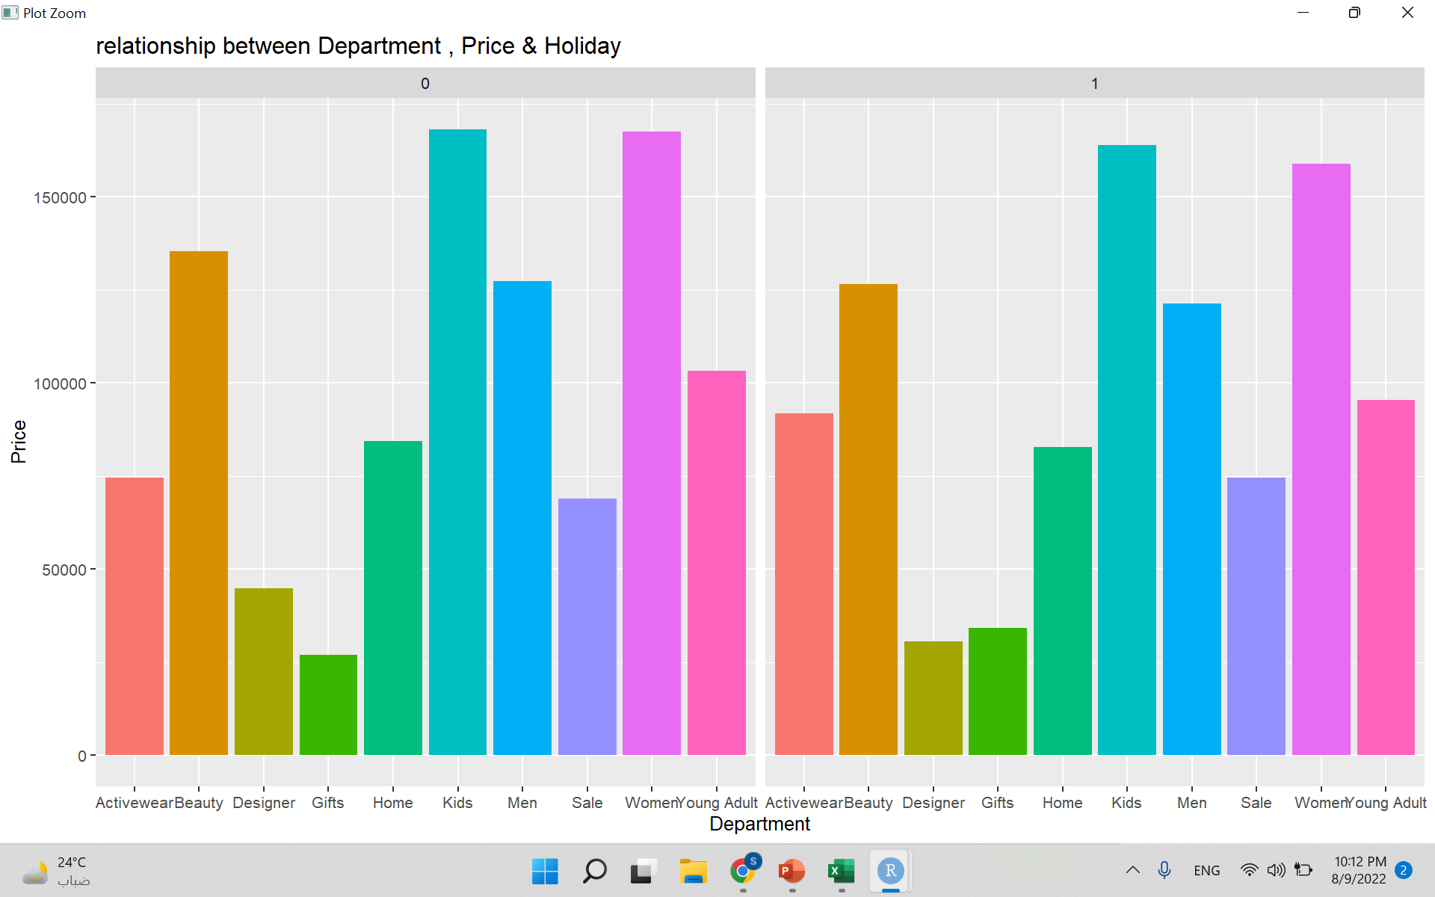
Relationship between Department , Price & Holiday
Barely noticed
Women and kids sell the most in general, more sales on non-holidays
*Note 1 represent for Holiday while 0 represent the rest days of the year

Slide 10
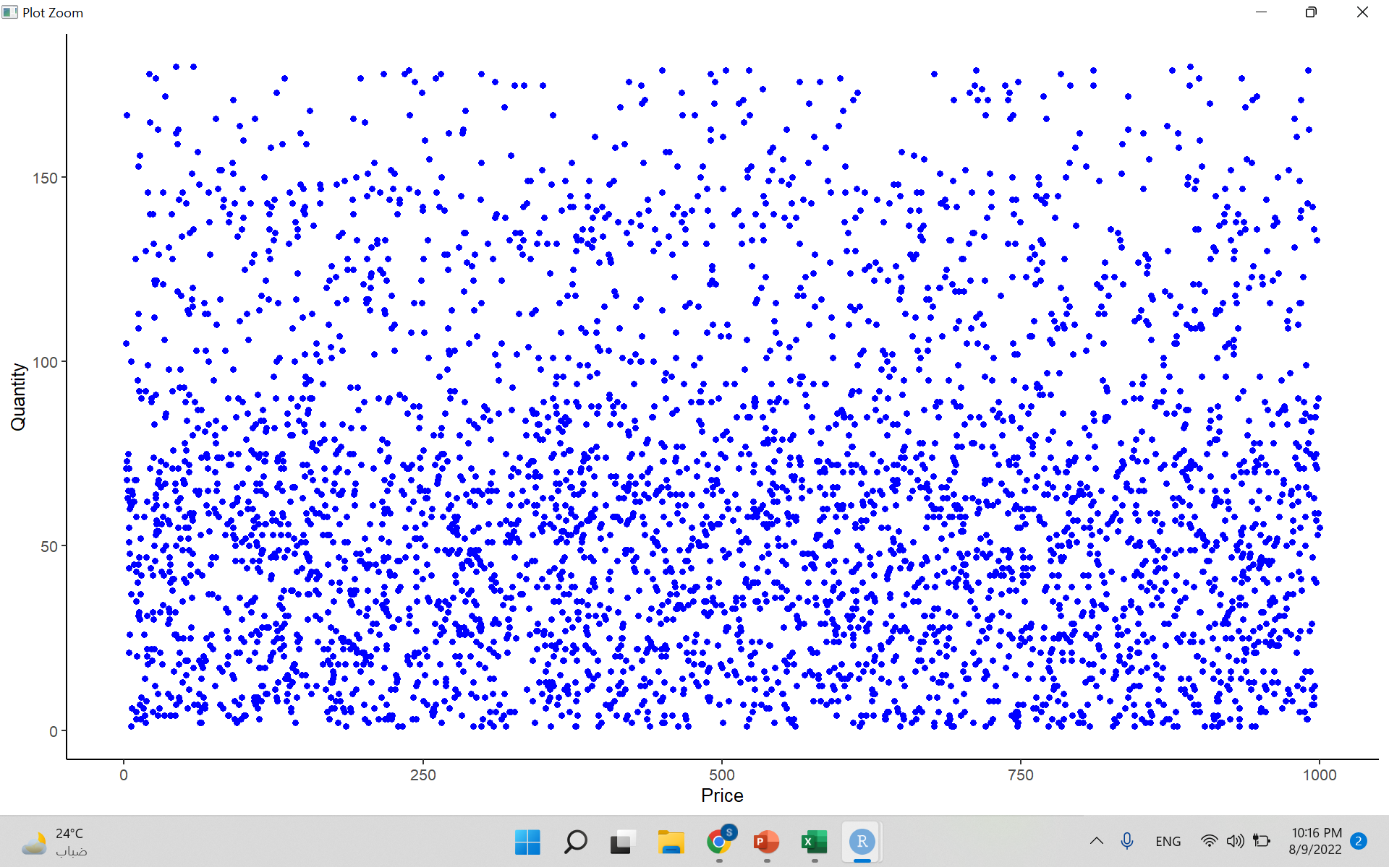
Relationship between quantity and price
No correlation between price and city density

Slide 11
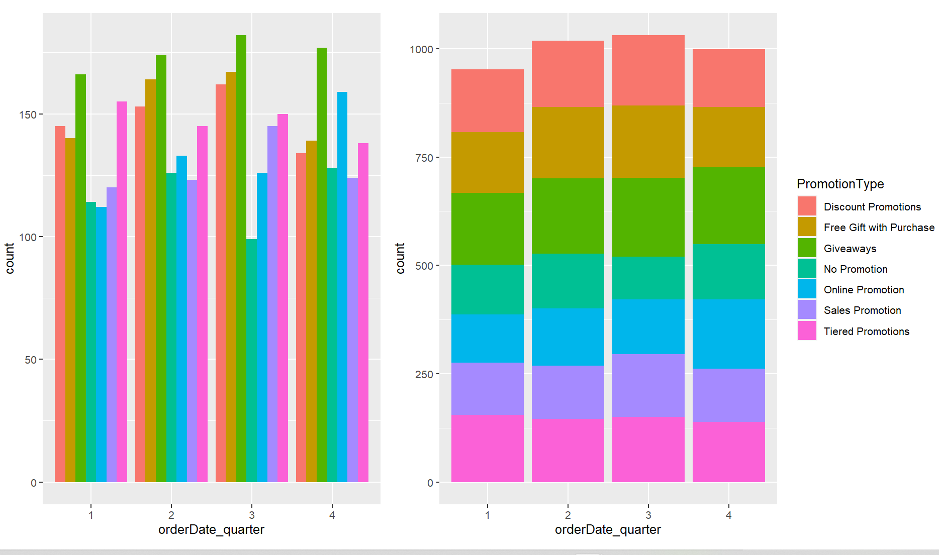
Relationship between when people order and what promotions are on
*not much difference in the number of promotions in each quarter the most
*common promotion is giveaways

Slide 12
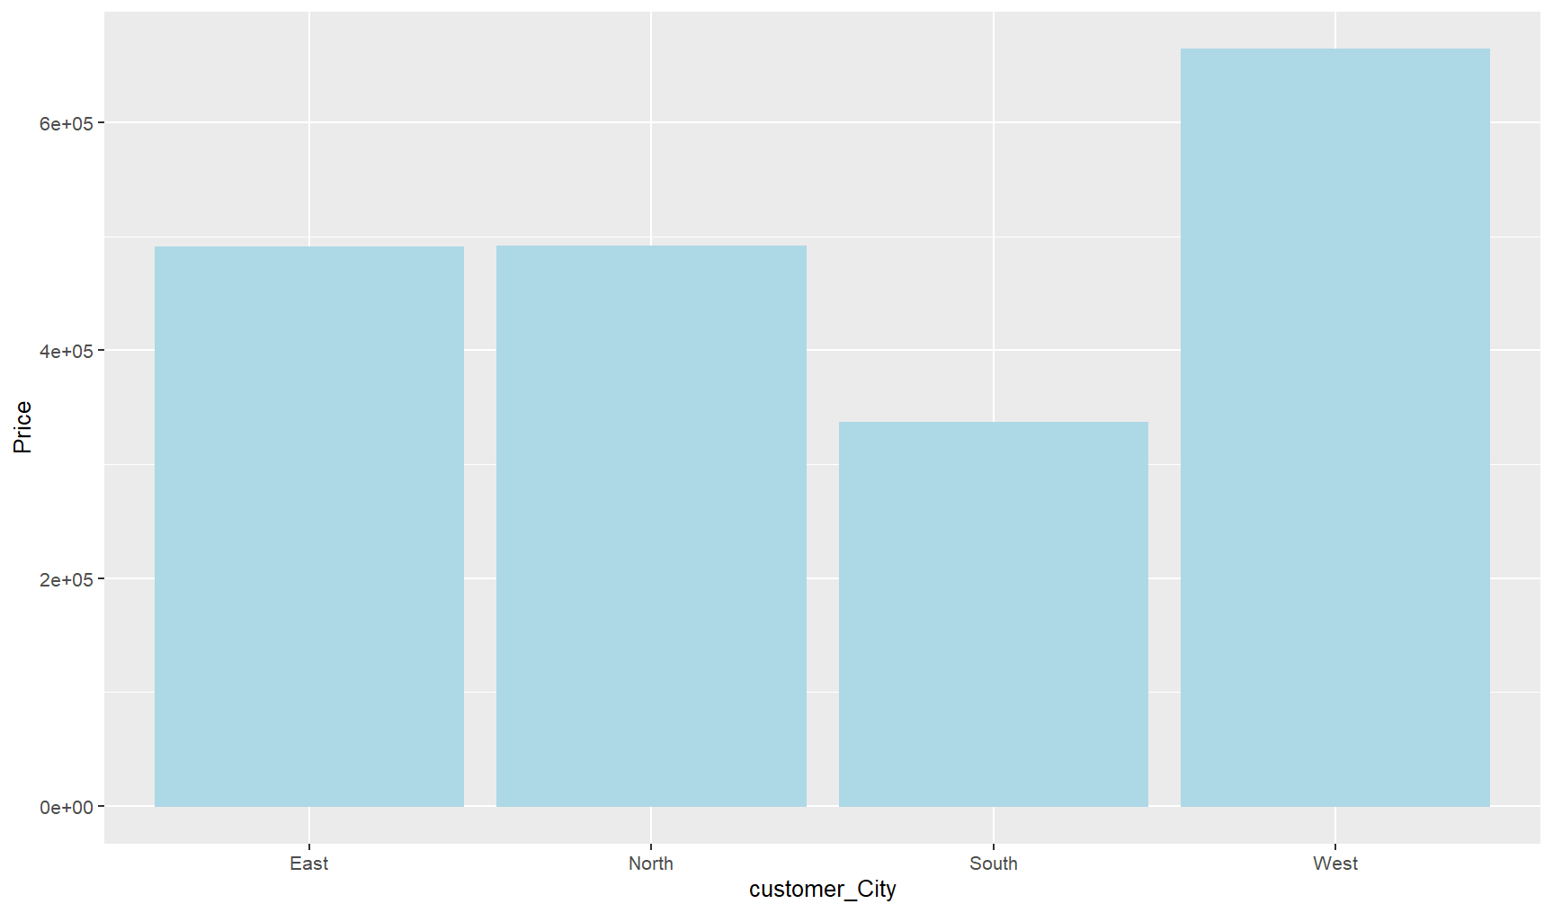
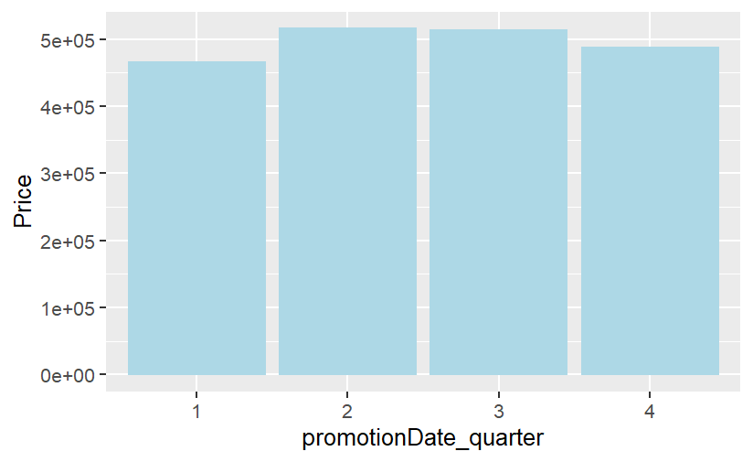
Price
price is not affected by the quarter when there was a promotion
Prices are the highest in the West region while they are the cheapest in the South

Slide 13
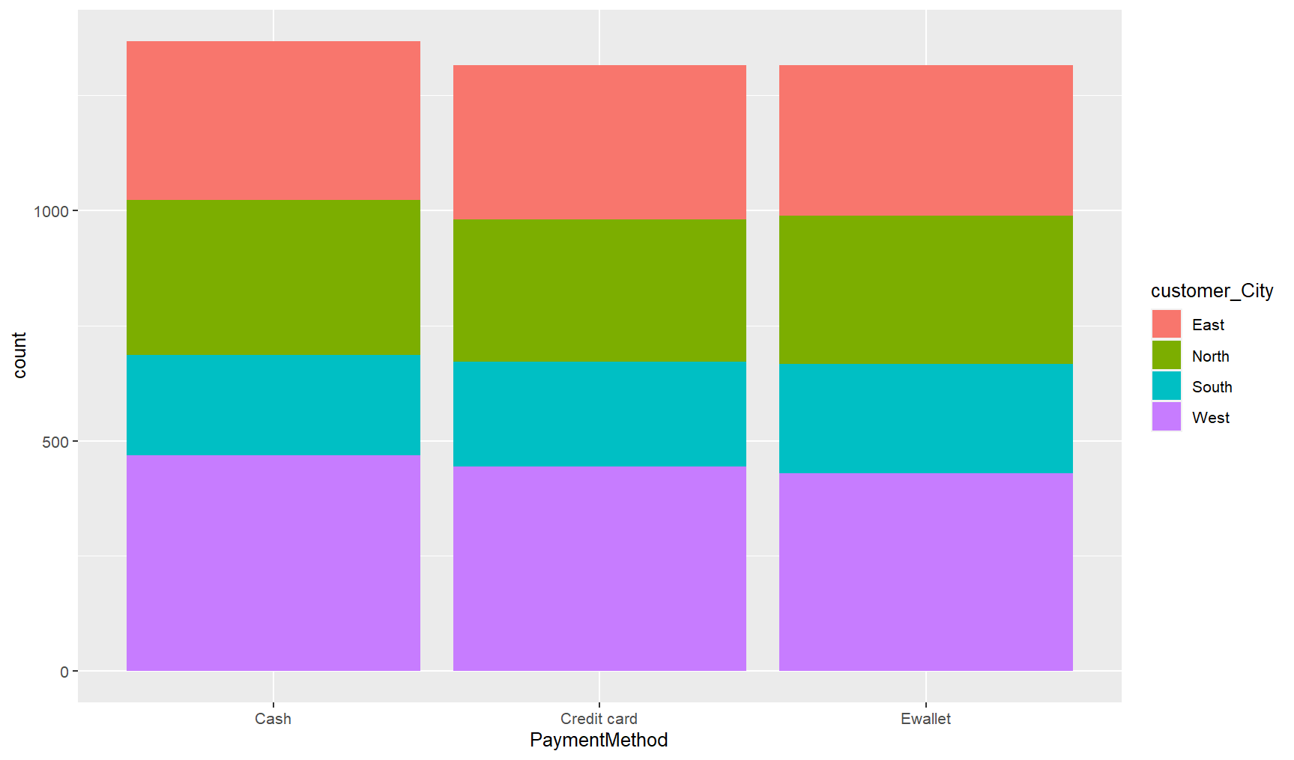
Payment Method according to customer City

Slide 14
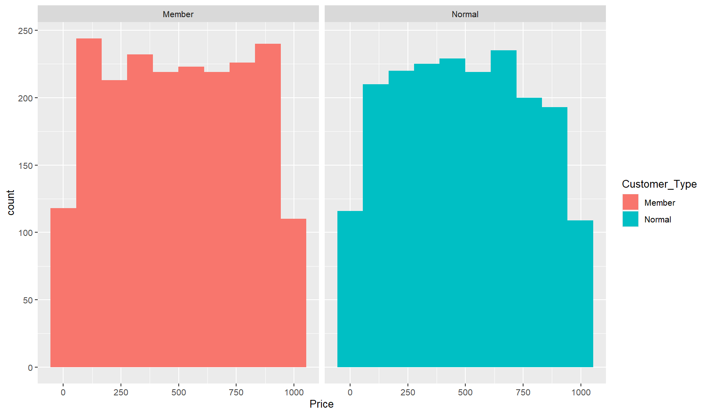
Price is the same regardless of customer type

Slide 15

Summary

Slide 16


Thank You
Team 2

